Slide 1
Mother Goose’s Variable Types

Slide 2

Quantitative
Data as numbers
AKA Continuous
AKA Numeric

Slide 3
Continuous
A number with decimal places
1.7, 2.4, 3.9

Slide 4
Discrete
A number without decimal places
Whole number
1, 2, 4

Slide 5

Qualitative
Data as words
AKA string
AKA character
Jack be Nimble
Jack be Quick
Jack Jumped over the Candlestick

Slide 6
Categorical
Type of qualitative data
Data that has specific groups and limited options
Jack Descriptors:
Nimble
Quick
Jumping

Slide 7
Ordinal
Categorical data that is ordered
Ex. Ranked from best-worst
Nursery Rhyme Ranking:
Little Bo Peep
Peter Piper
Little Boy Blue

Slide 8
Examples

Slide 9
The Premise
Dataset filled with nursery rhyme variables
For each example, you will answer what kind of variable you have.

Slide 10
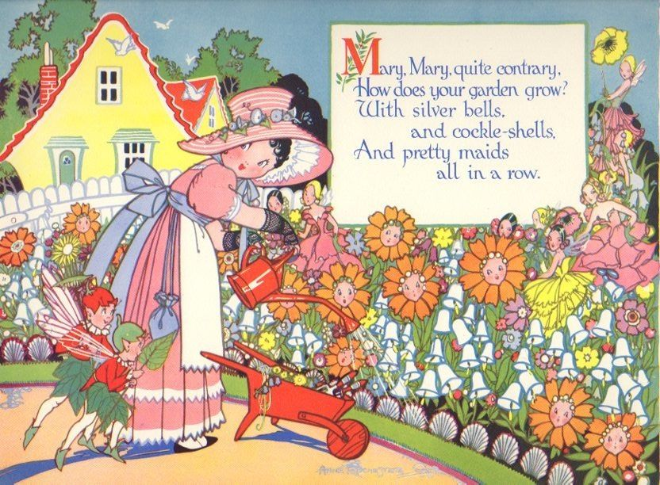
The color of Mary, Mary’s cockleshells:
Qualitative, Categorical

Slide 11
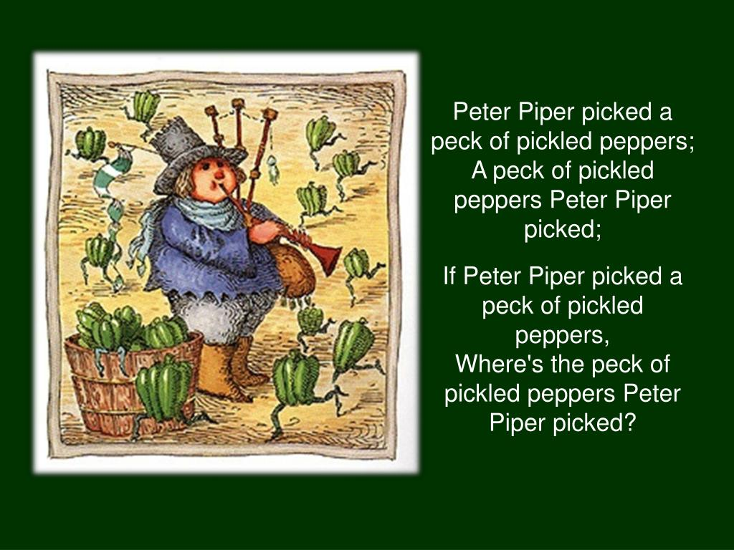
The Number of Peppers Peter Piper Picked
Quantitative, Discrete

Slide 12

The Length of the Waggly Tail for the Puppy in the Window.
Quantitative, Continuous
Quantitative, Continuous

Slide 13
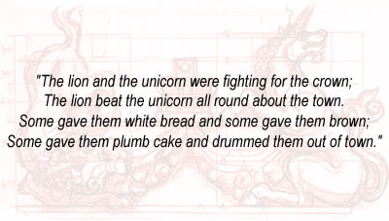
The Text of the Lion and the Unicorn
Qualitative

Slide 14
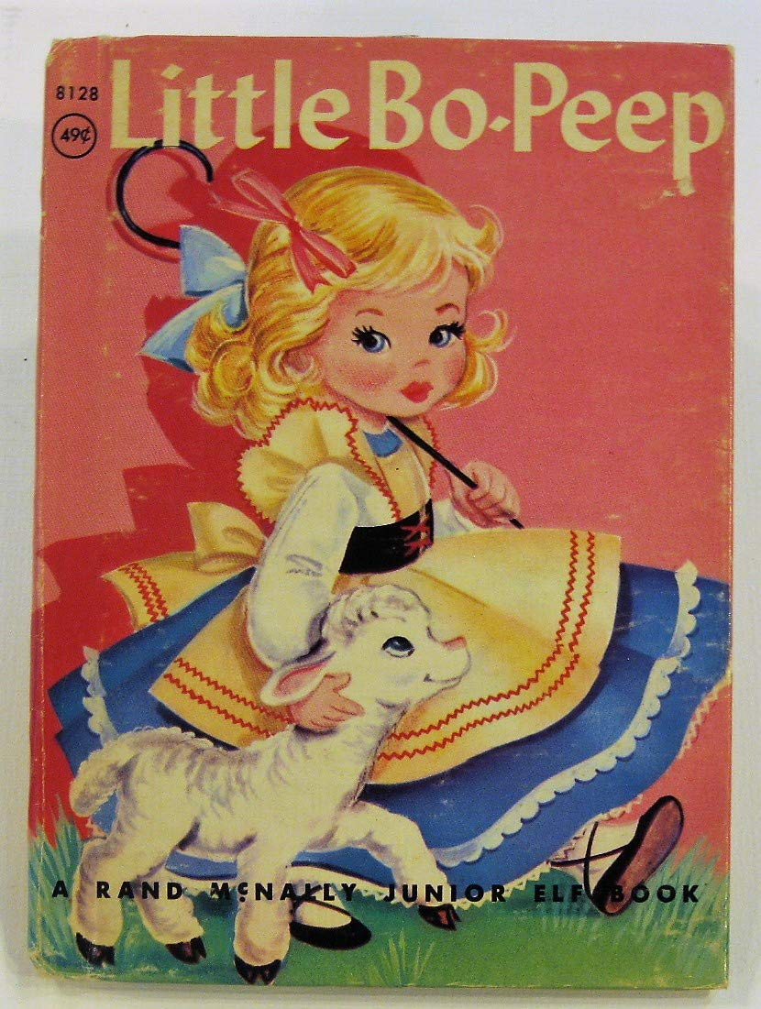
The Number of Sheep Little Bo Peep Lost
Quantitative, Discrete

Slide 15
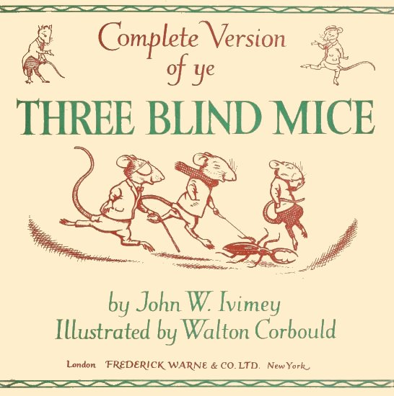
Rankings of the Three Blind Mice from Best to Worst
Qualitative, Categorical, Ordinal

Slide 16
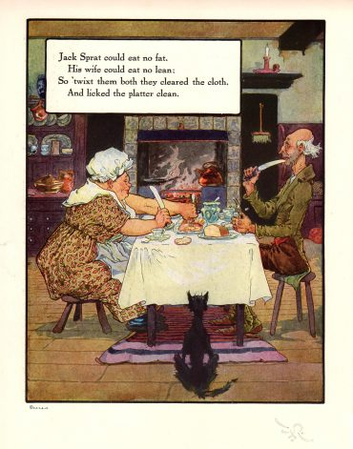
The Types of Things Jack Sprat and his Wife Could Eat
Qualitative, Categorical

Slide 17
Questions?

